Slide 1

Bypass Gastrico Roux-en-Y versus OAGB, risultati a confronto
Mario Musella MD.
Full Professor of General Surgery
SICOB Vice President
Past President MGB-OAGB International Club
IFSO Educational Committe Member
Advanced Biomedical Sciences Department
‘’Federico II’’ University – Naples, Italy

Slide 2
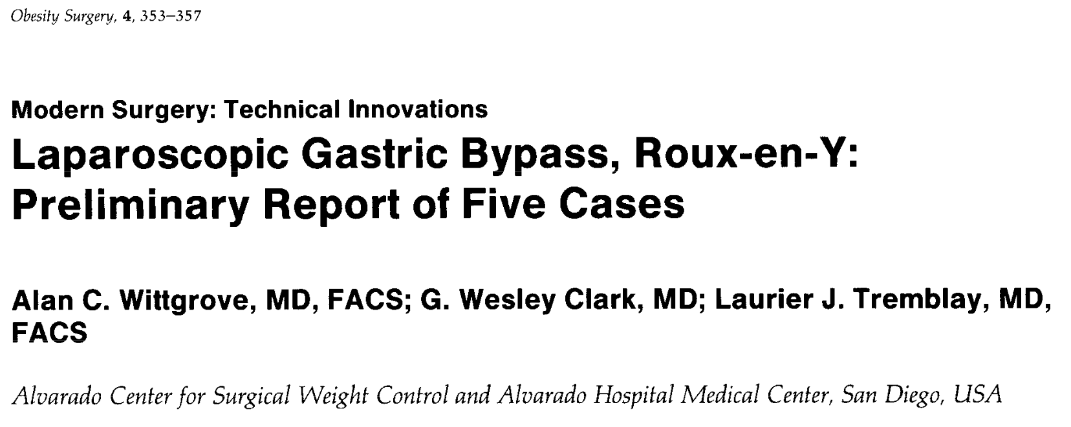
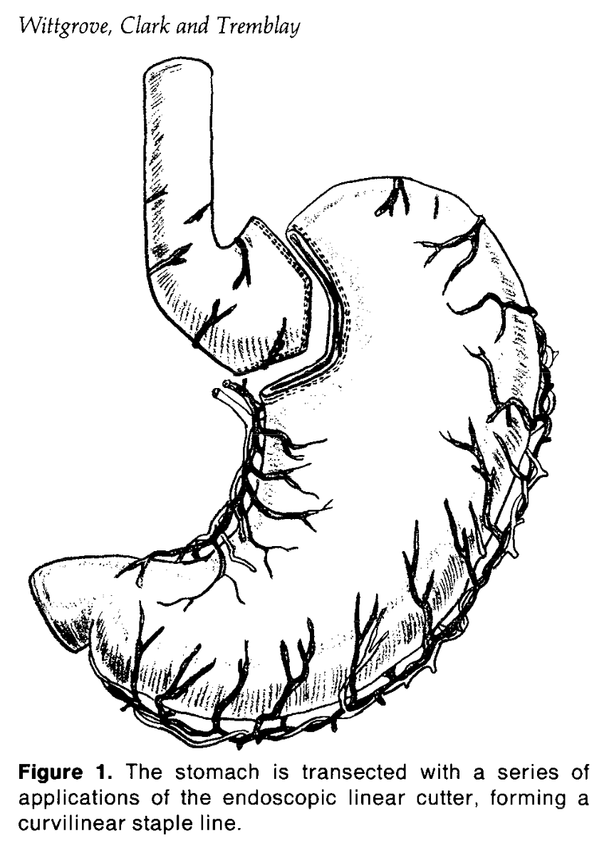
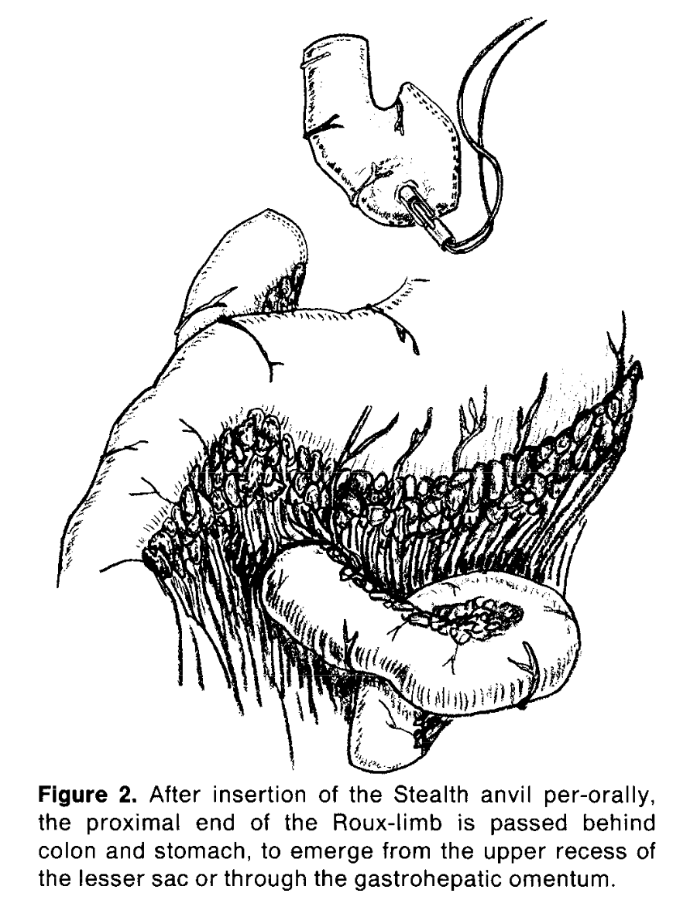
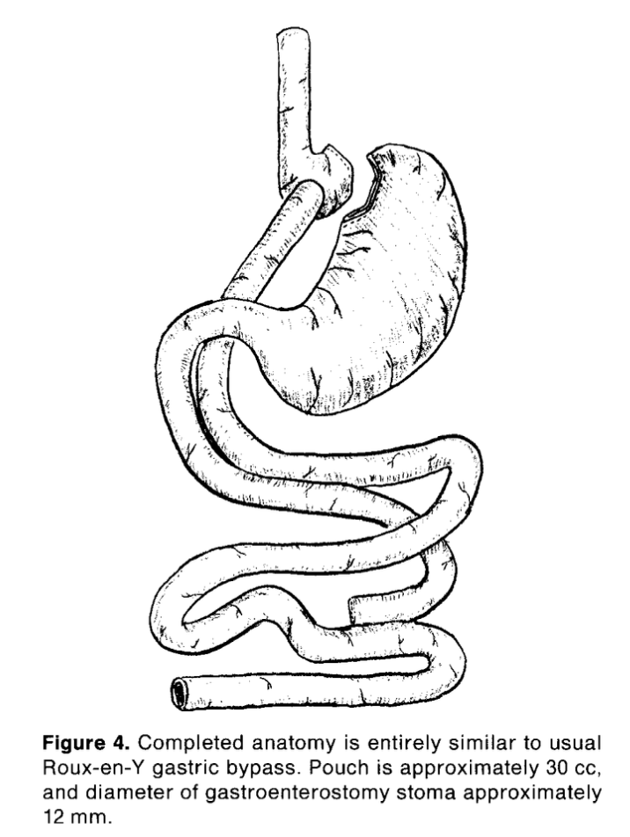


Slide 3
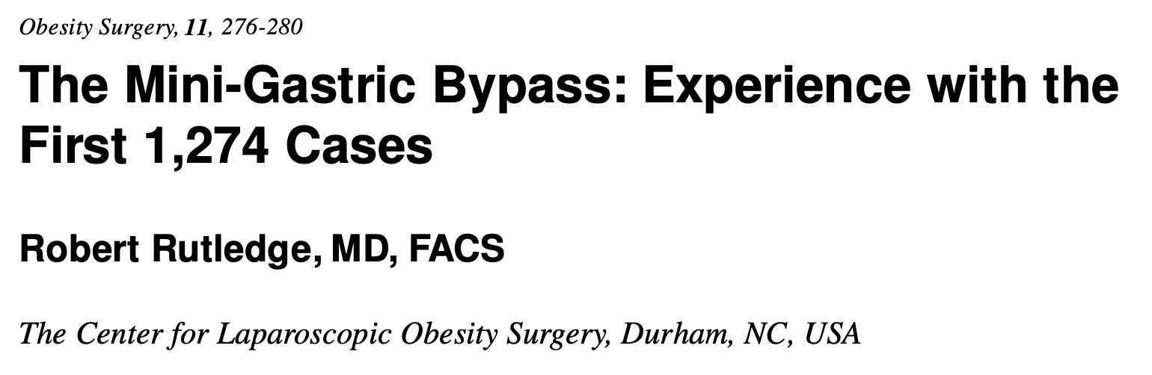
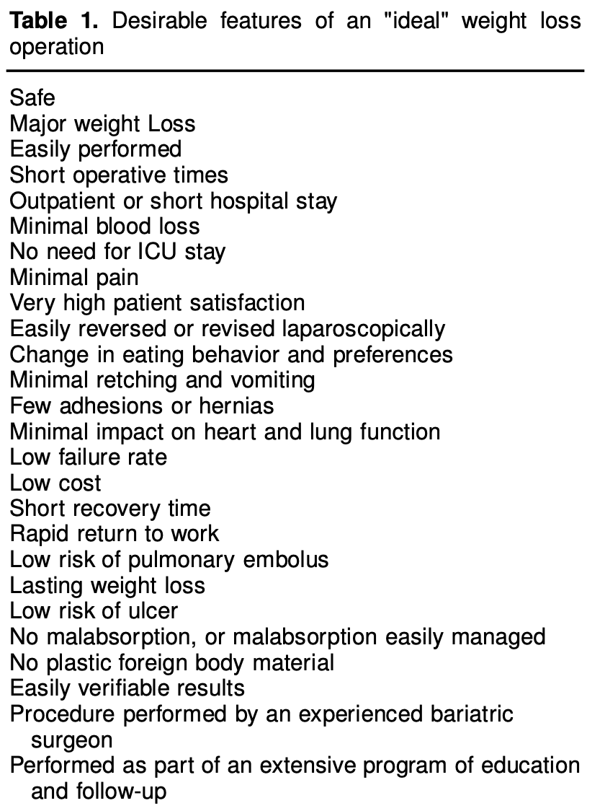
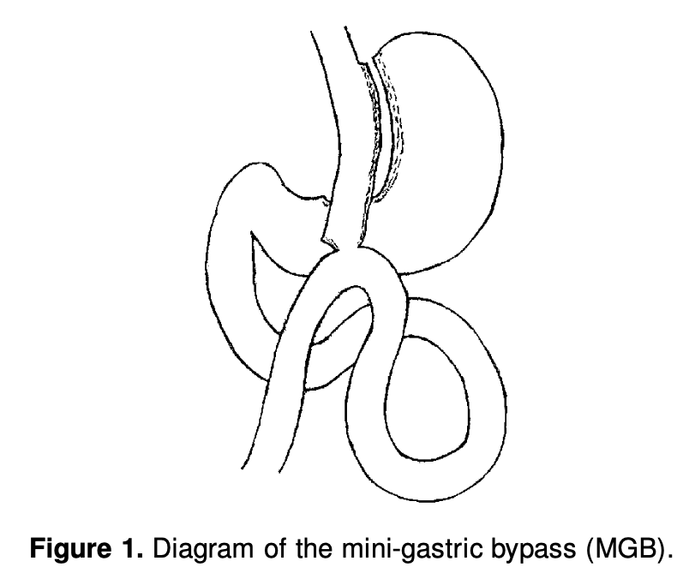
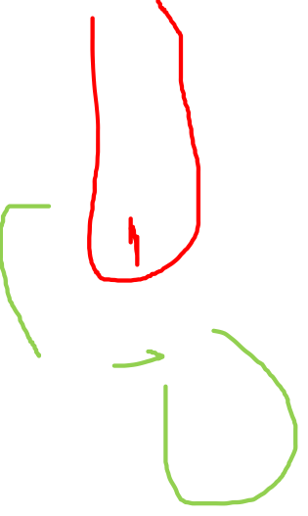

Slide 4
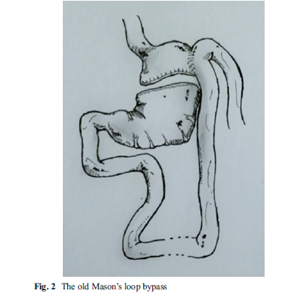
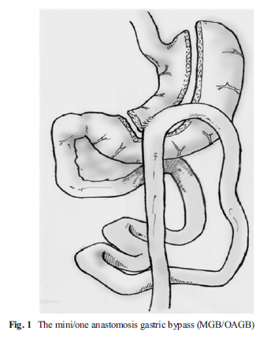

MGB/OAGB in Italy 2006-2016
180 – 220 cm from Treitz ligament

Slide 5

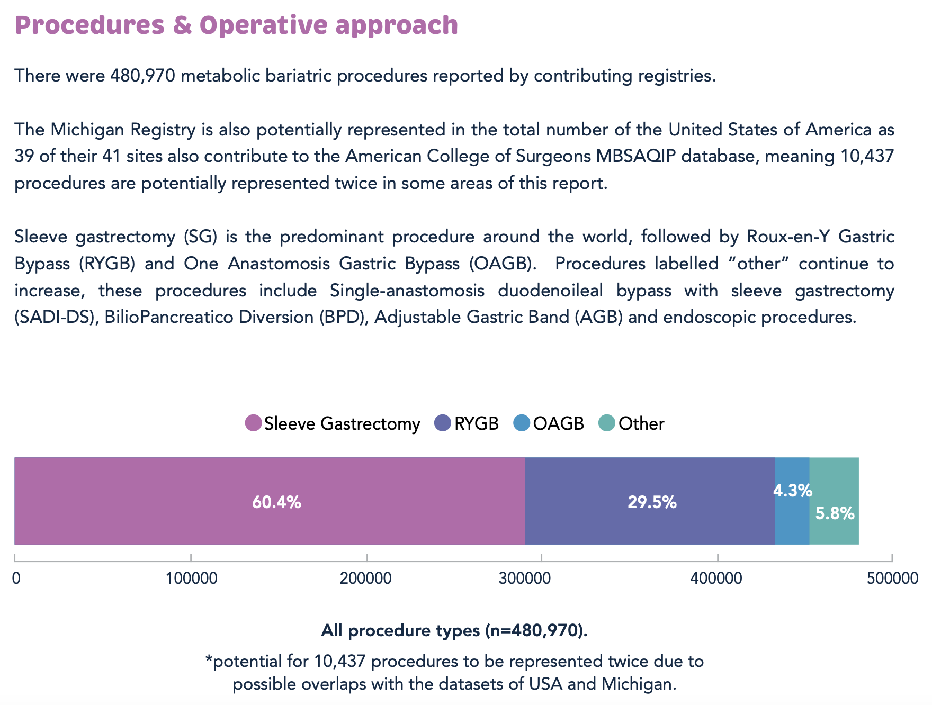

Slide 6
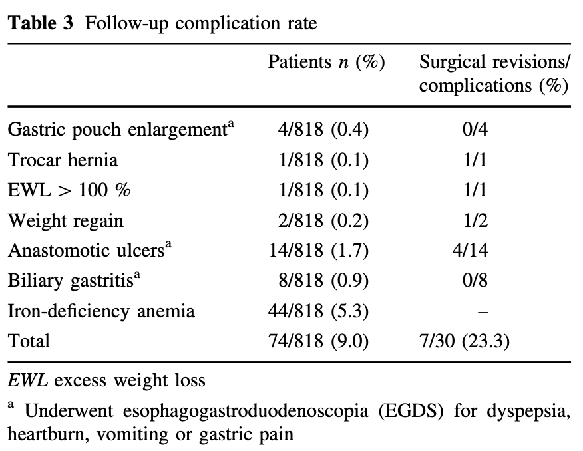
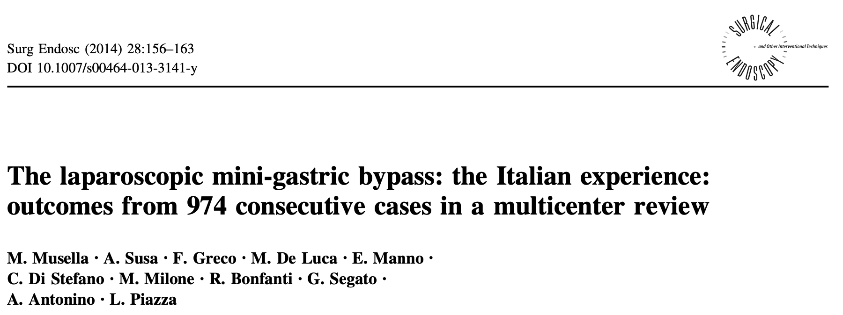
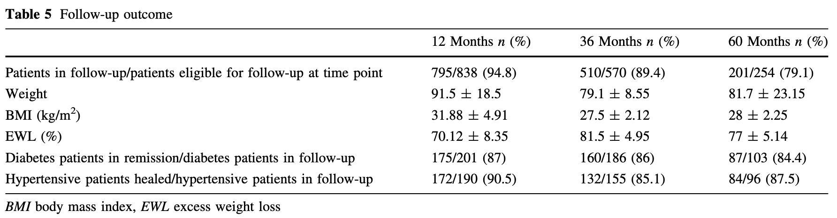

Slide 7
WL%

Slide 8
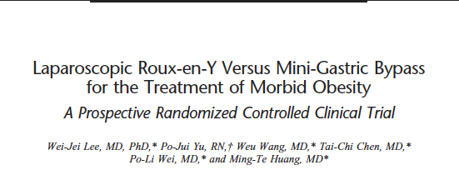
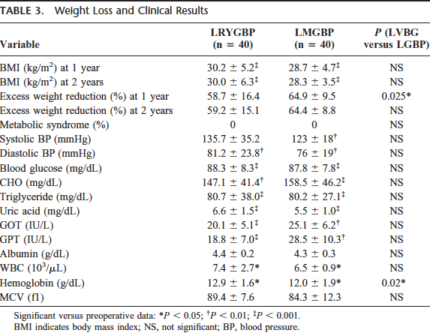
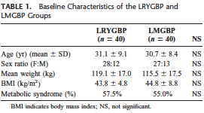

Slide 9
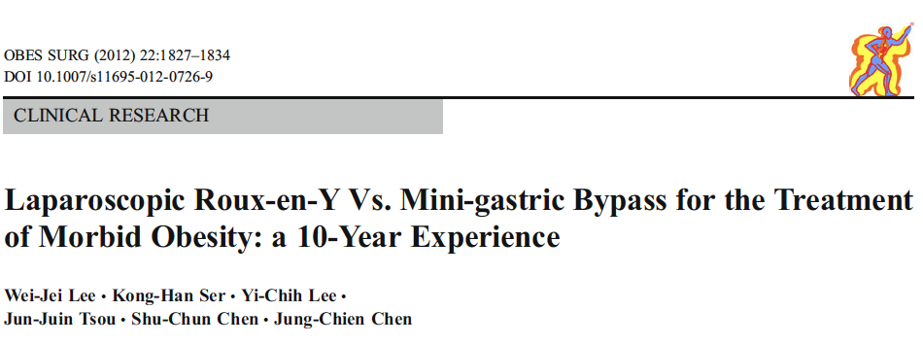
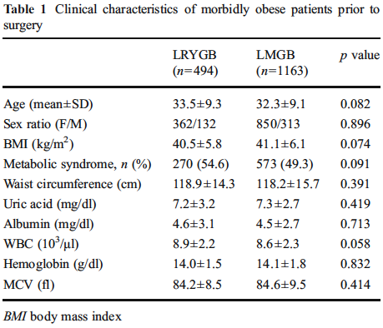
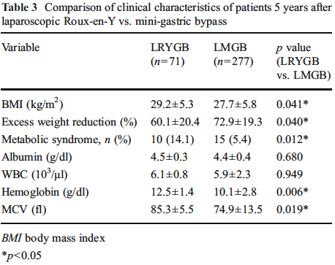

Slide 10
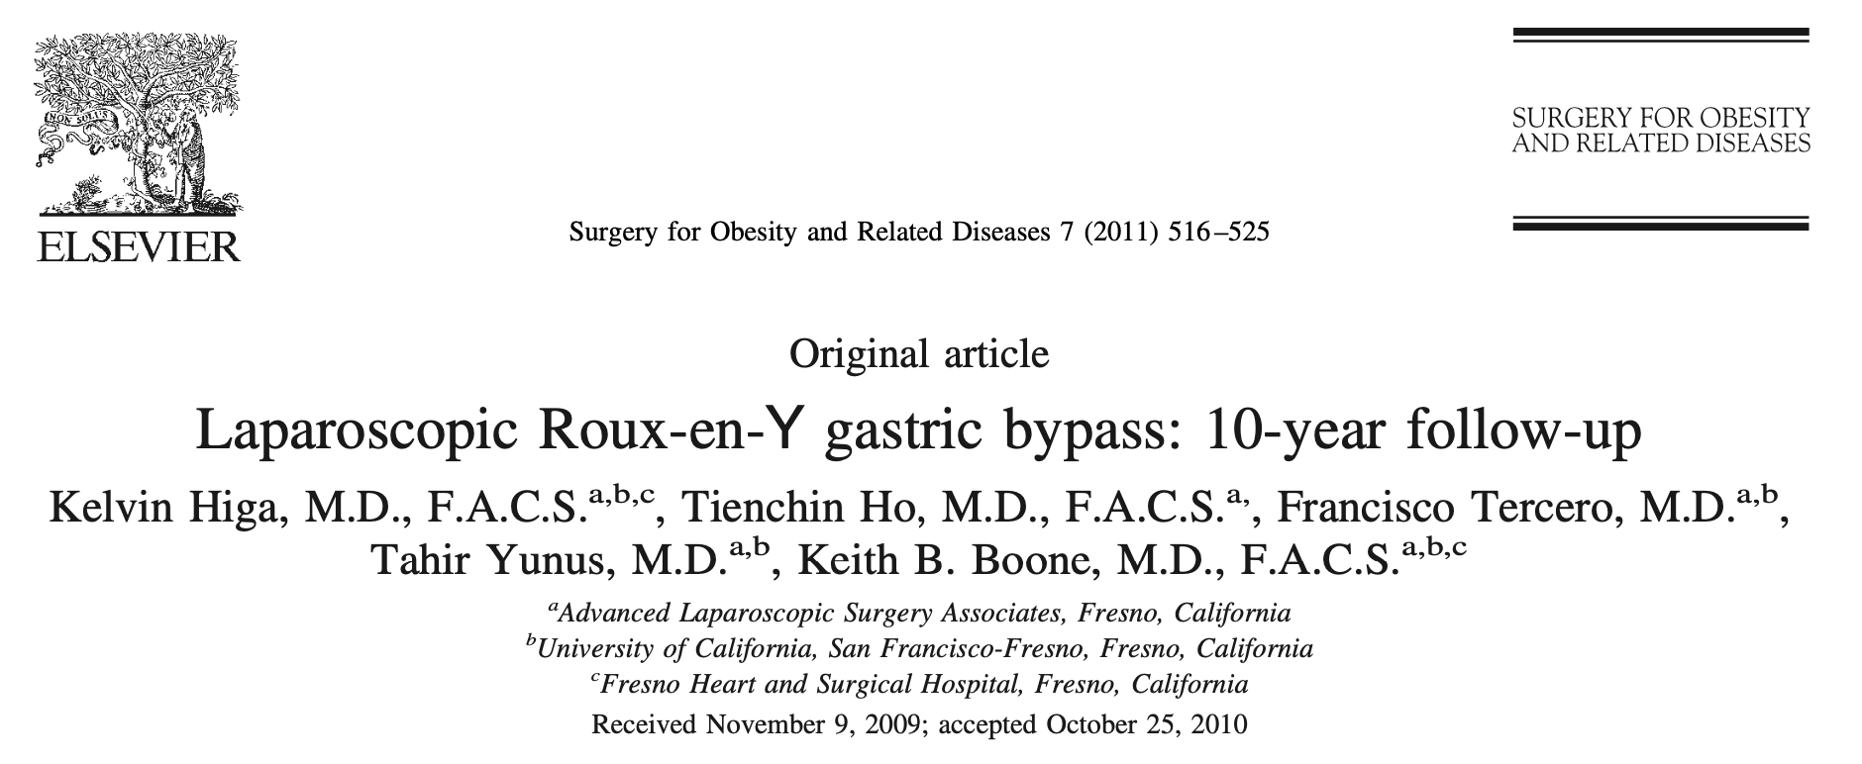
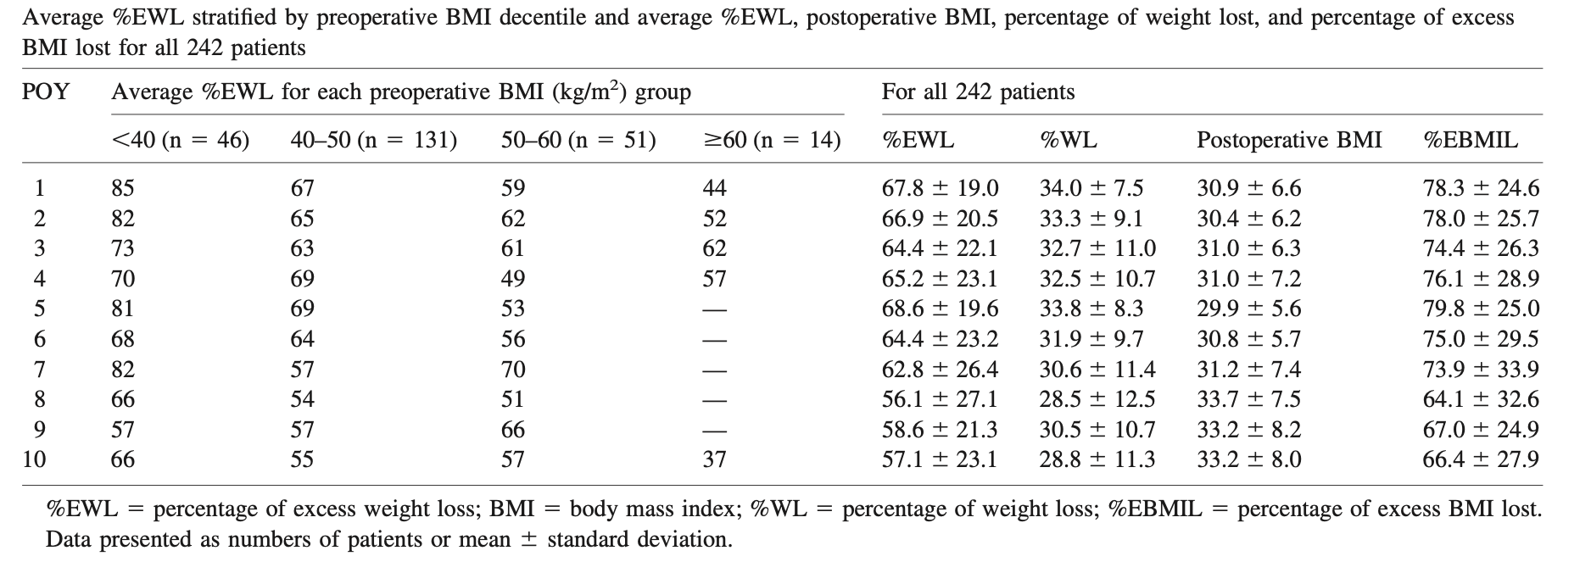

Slide 11
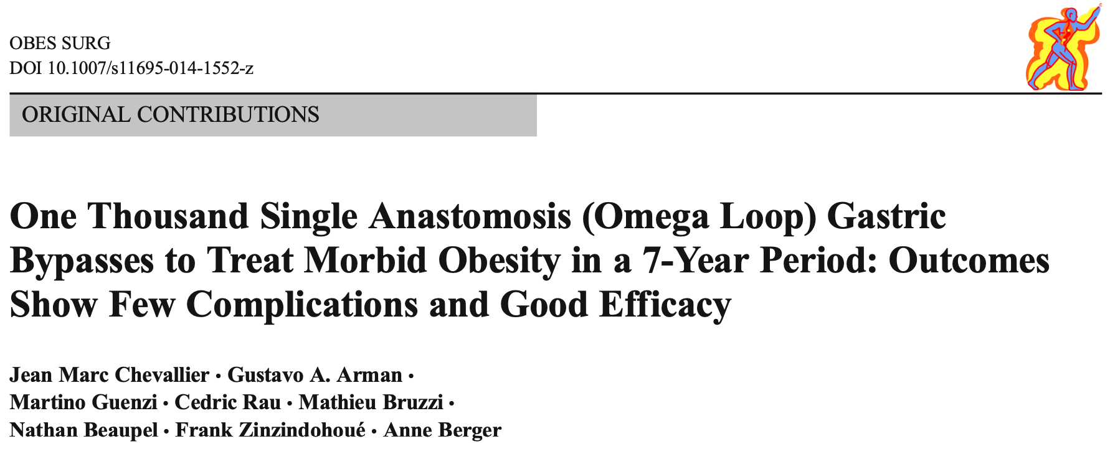
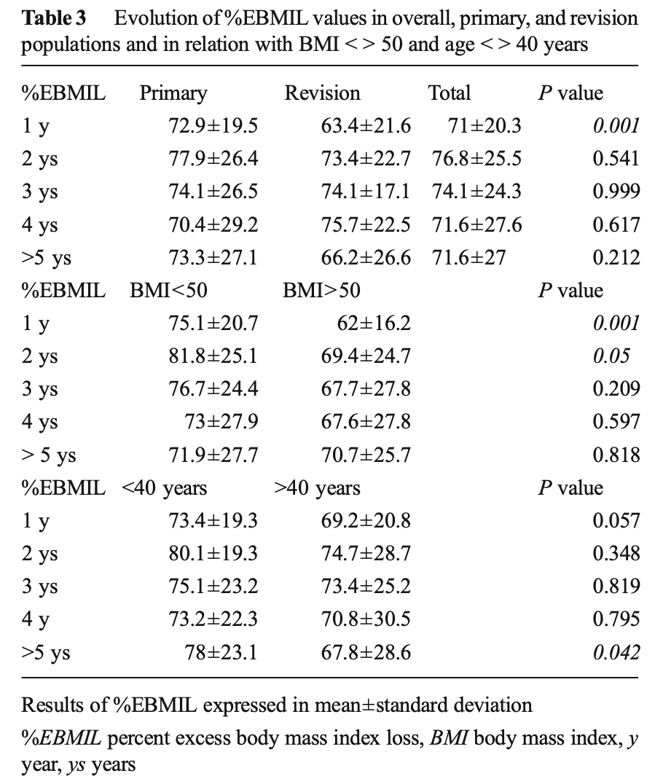
At 5 years, mean BMI was 31.5 ± 6.2 kg/m2 (range, 19–51) and the mean %EBMIL was 71.6±27 % (range, 8.75–124).
At 4–5 years, the %EBMIL did not significantly differ from that after 1 year.
Five percent (n=49) of patients had a ≤25 % EBMIL and had to be considered as weight-loss failures.
Malnutrition occurred in two patients who had excessive weight loss (%EBMIL >100 % and albuminemia <30 g/L). Their mean BMI at 5 years was 19 kg/m2 and %EBMIL was 124 and 122 %
Remission rate from type-2 diabetes (defined by the American Diabetes Association as glycated hemoglobin of <6.5 % with- out any medication) was 85.7 %, after a mean follow-up pe- riod of 26 months, without any recurrence of diabetes. At 2 years, the resolution rate was 80.6 % for dyslipidemia, 52.1 % for high blood pressure, 50 % for sleep apnea, and 36.5 % had less joint pain.

Slide 12
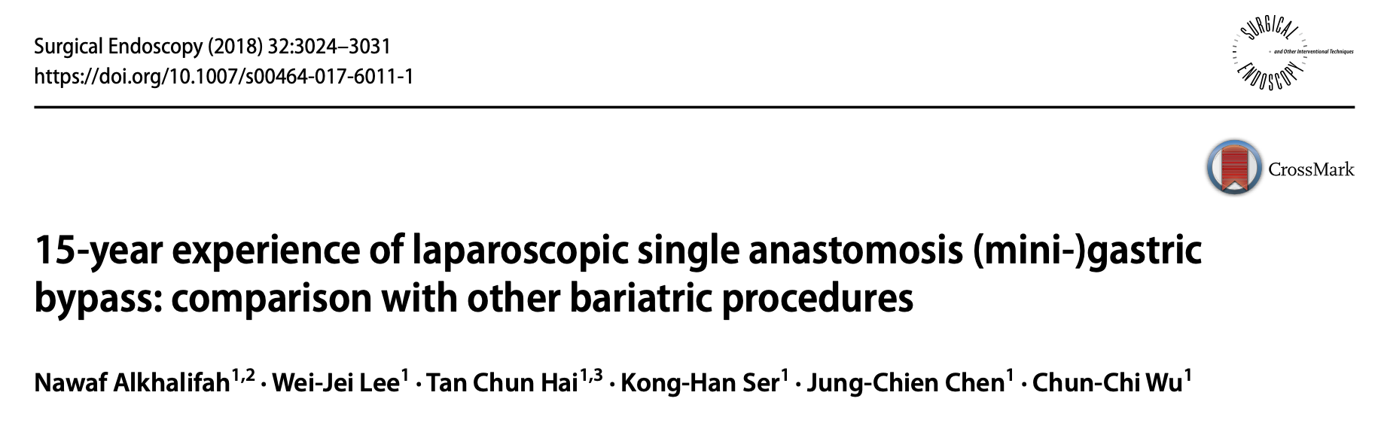
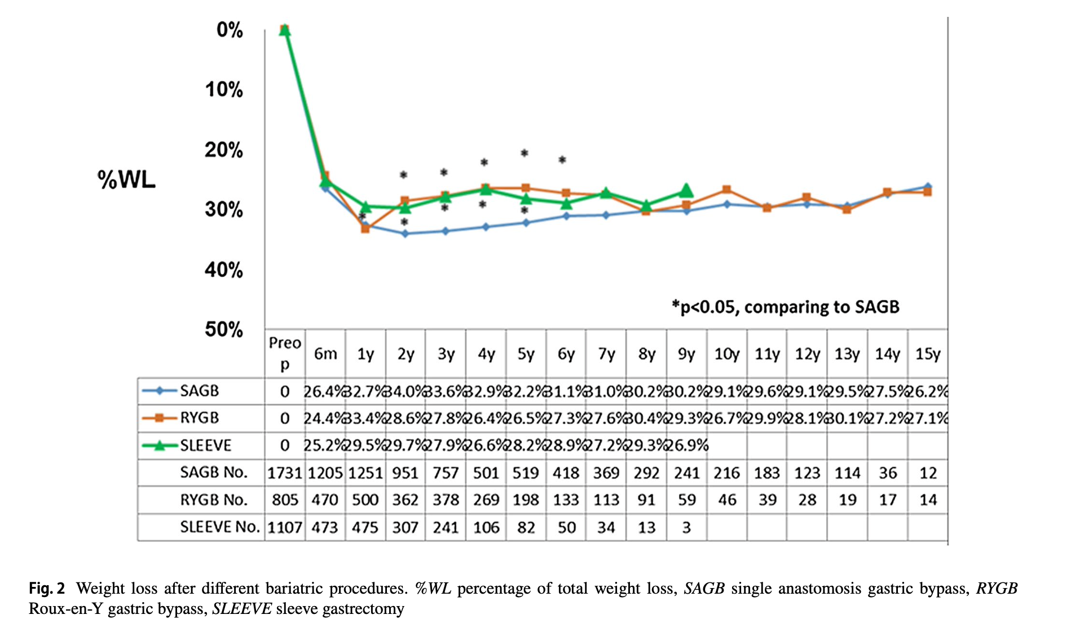

Slide 13
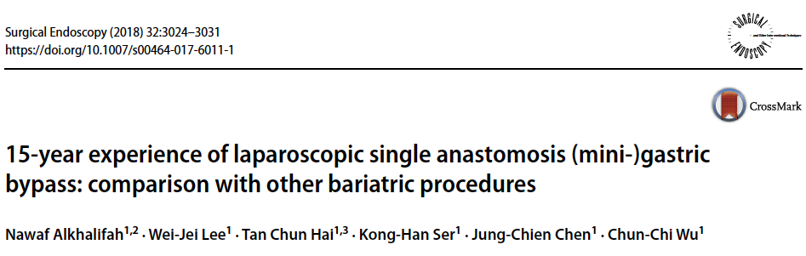
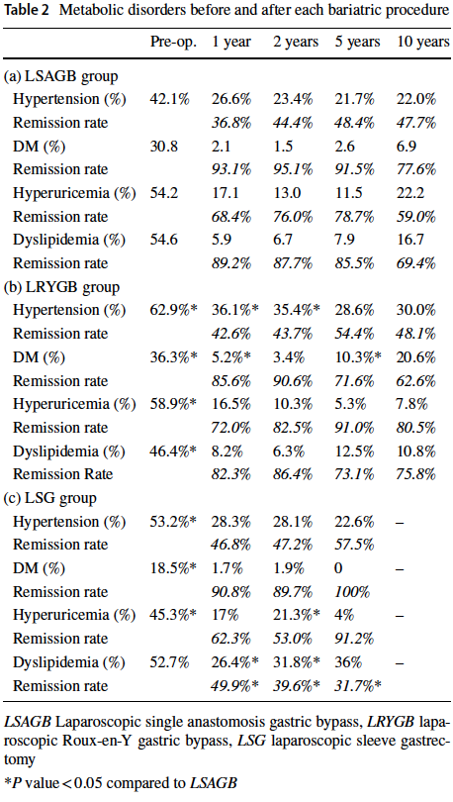
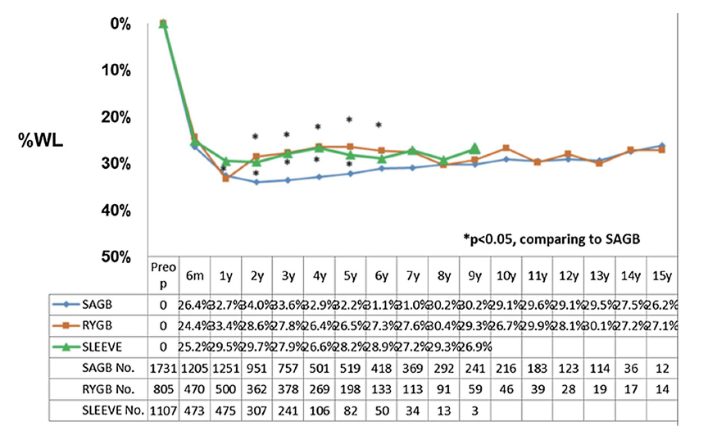

Slide 14
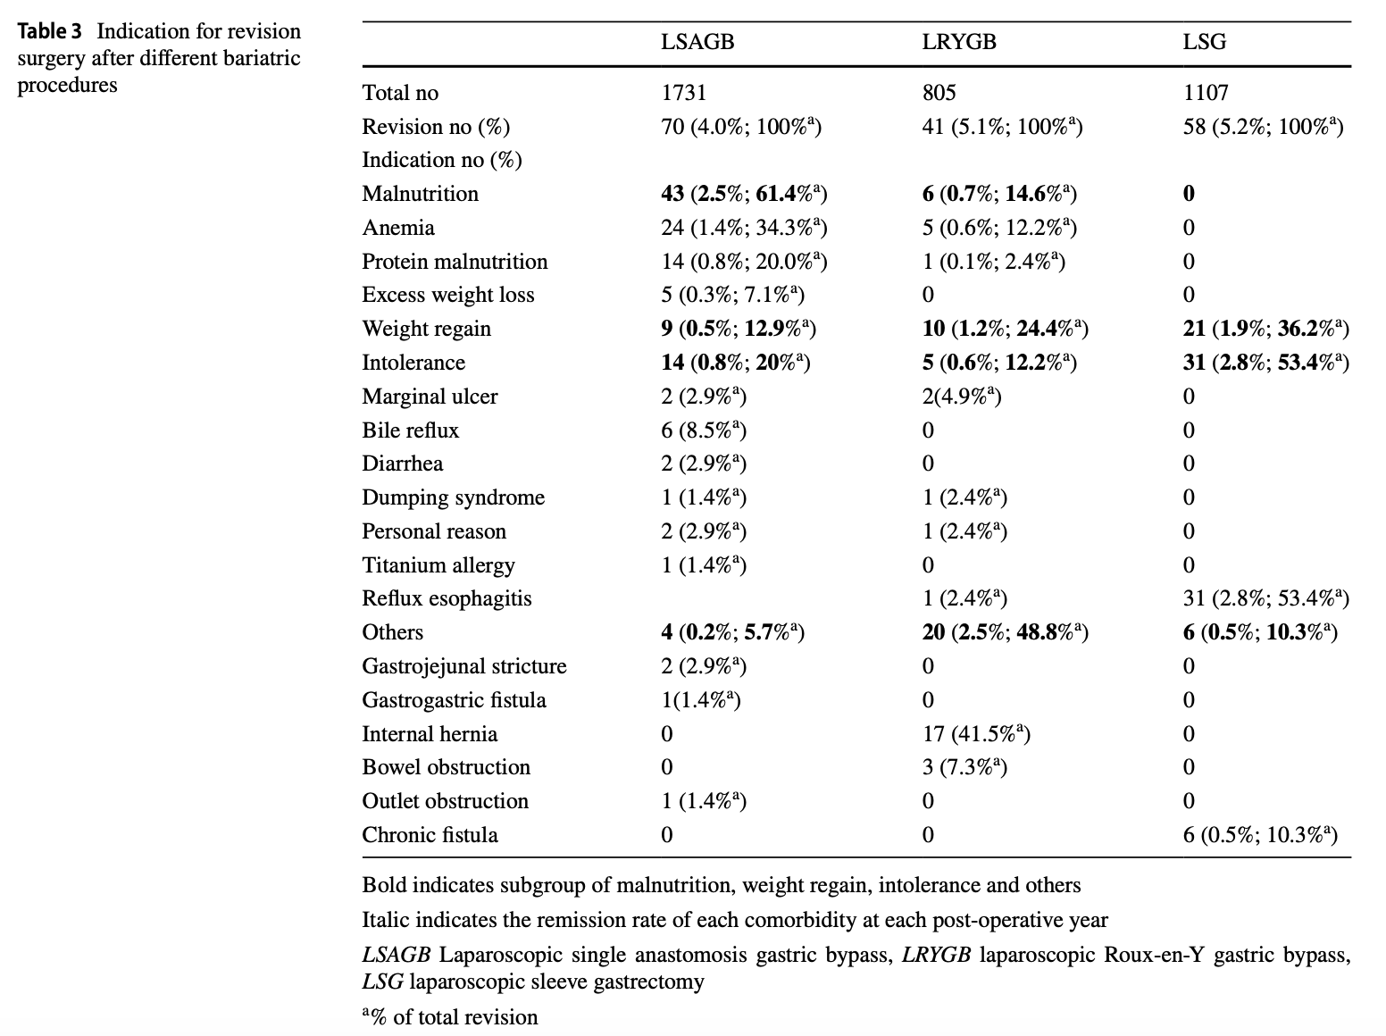
In conclusion, present study of LSAGB shows that this procedure is a safe and durable primary bariatric procedure with overall 29.1% WL at 10 years and satisfactory resolution of obesity-related comorbidities. The need for revision of LSAGB (4.0%) is lower than LRYGB and LSG. The revision is indicated mainly for anemia or protein malnutrition.

Slide 15
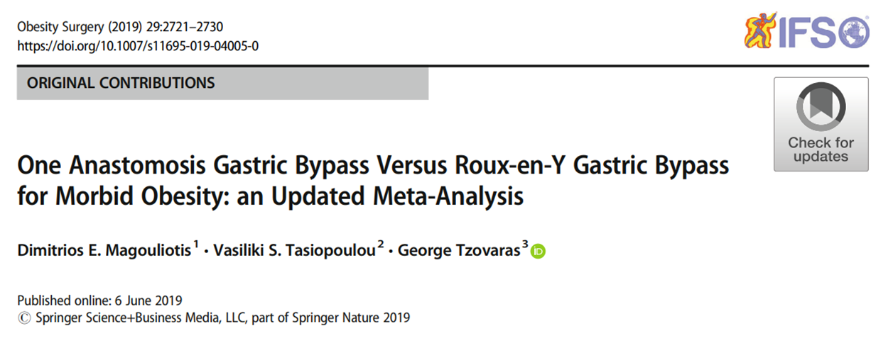
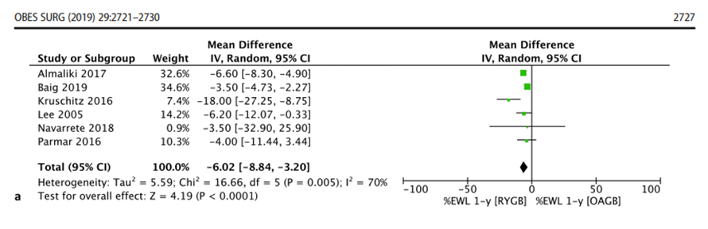
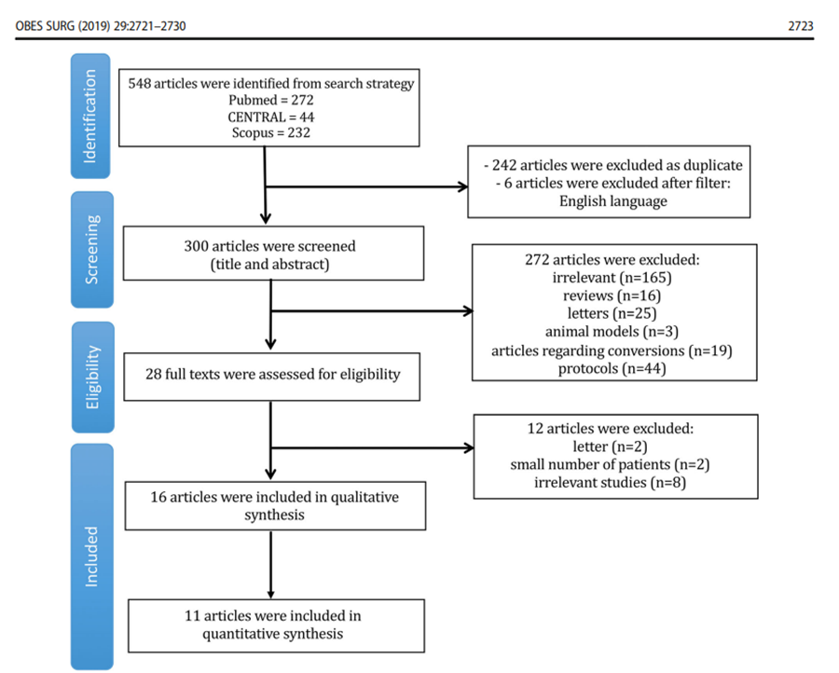
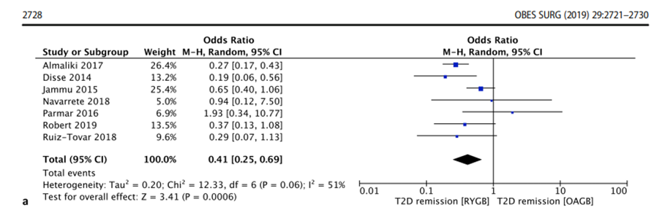
12.445 patients: 7.944 treated with OAGB and 4.501 with RYGB
The present meta-analysis demonstrates the superiority of OAGB compared with RYGB, in terms of weight loss and diabetes remission

Slide 16
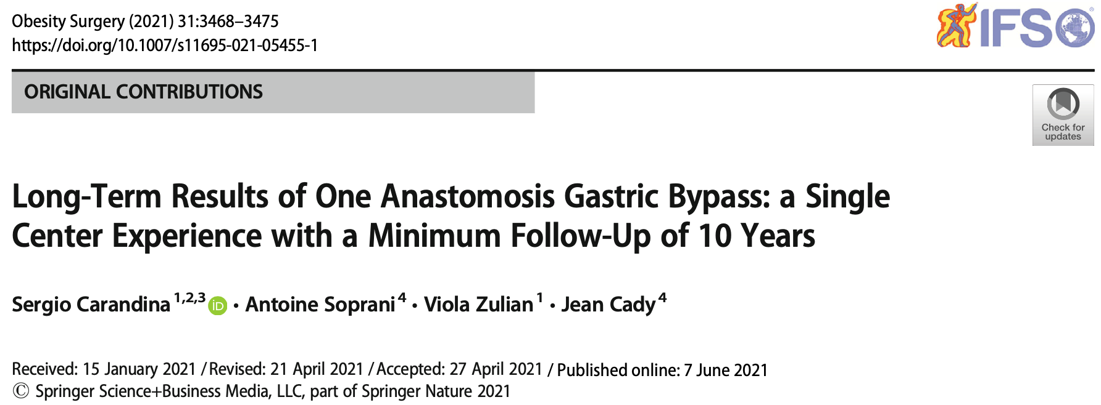
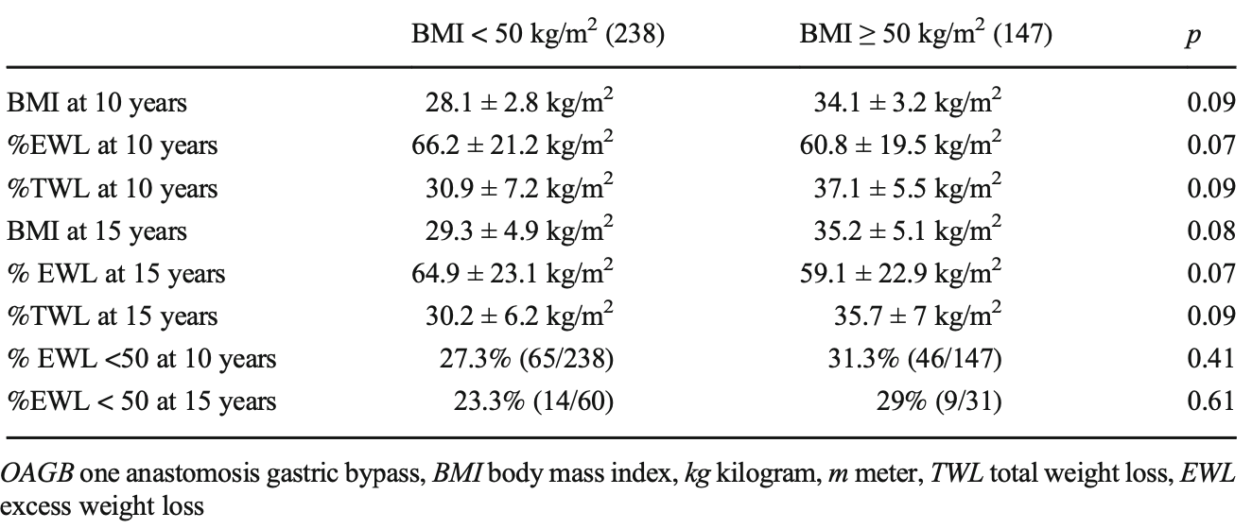
In conclusion, at 10 years of follow-up, the average weight loss was 33% of total weight loss with a percentage of diabetes, hypertension, and sleep apnea resolution or improvement respectively of 90%, 85%, and 90%. Concerns about OAGB include the risk of clinically significant malnutrition, which was 2.3 %, and the risk of bile reflux which was 10% with 60% requiring corrective surgery.

Slide 17
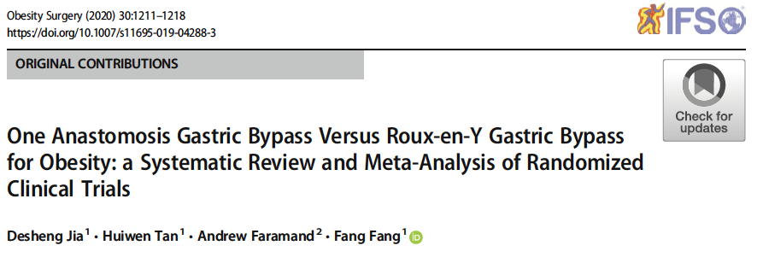
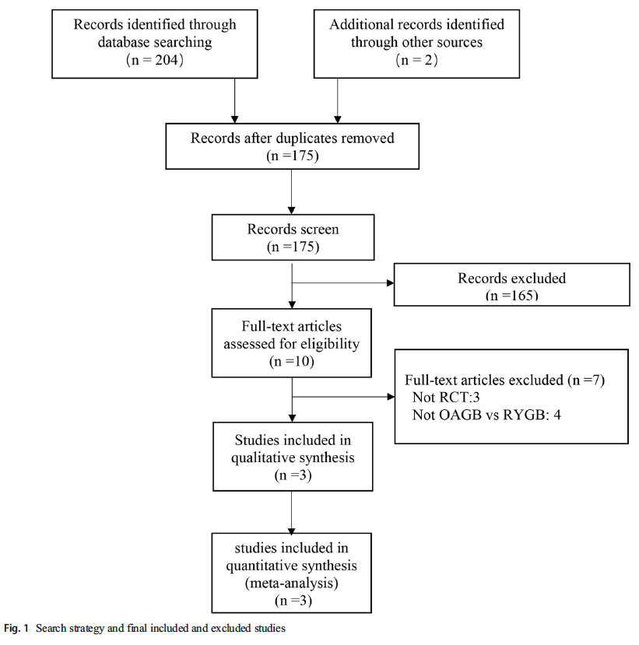
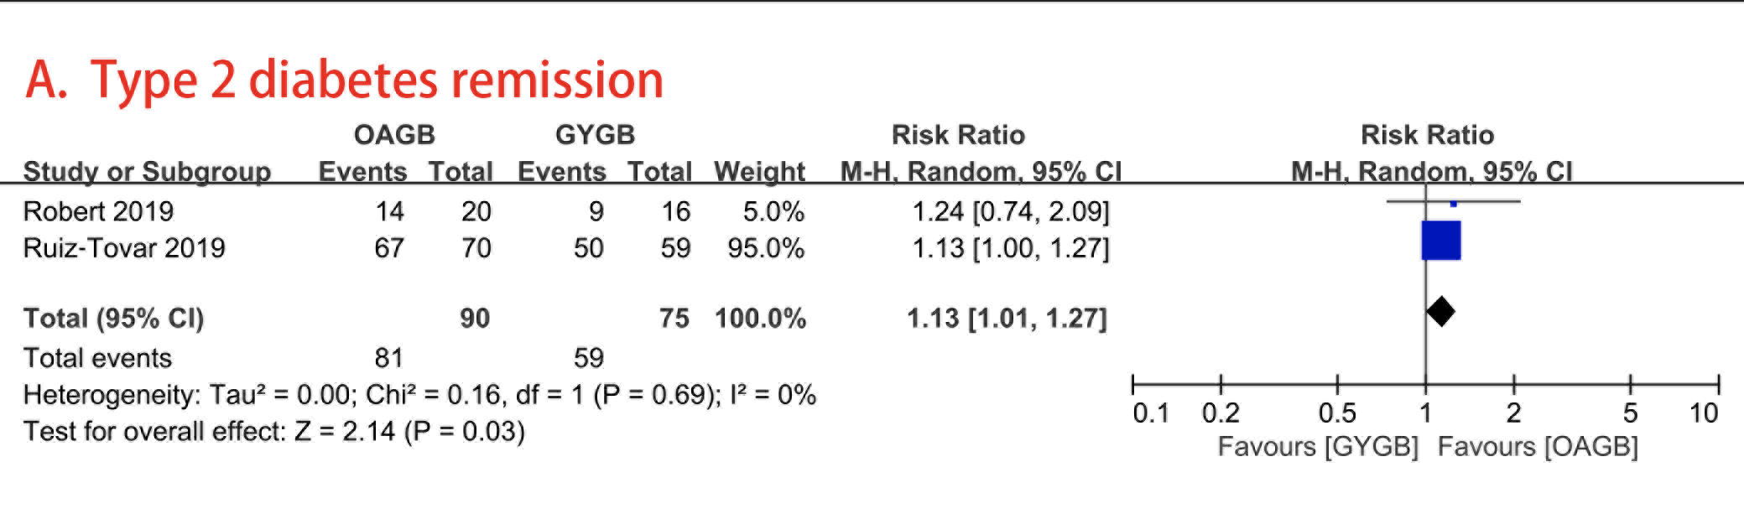
733 patients: 364 treated with OAGB and 369 with RYGB
The present meta-analysis demonstrates the superiority of OAGB compared with RYGB, in terms of weight loss and diabetes remission

Slide 18
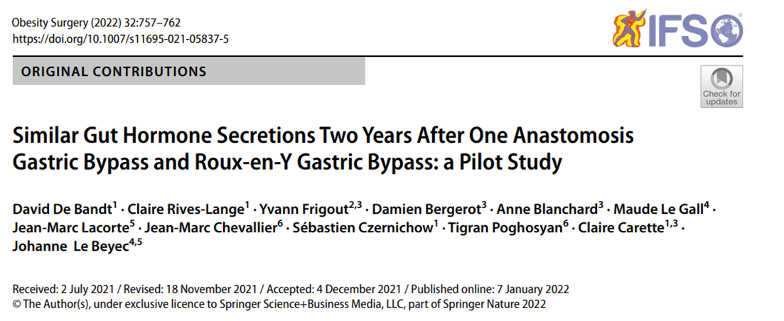
This is the first clinical study showing that OAGB procedure results in high postprandial secretions of gut hormones as observed in RYGB procedure, in particular GLP-1

Slide 19
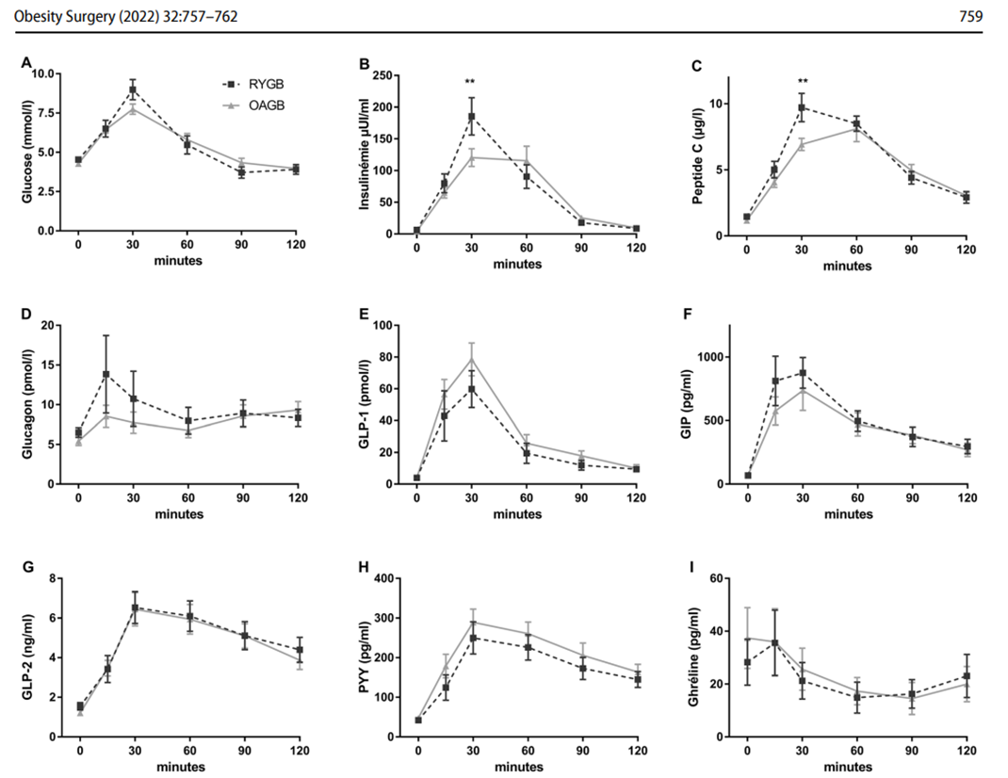
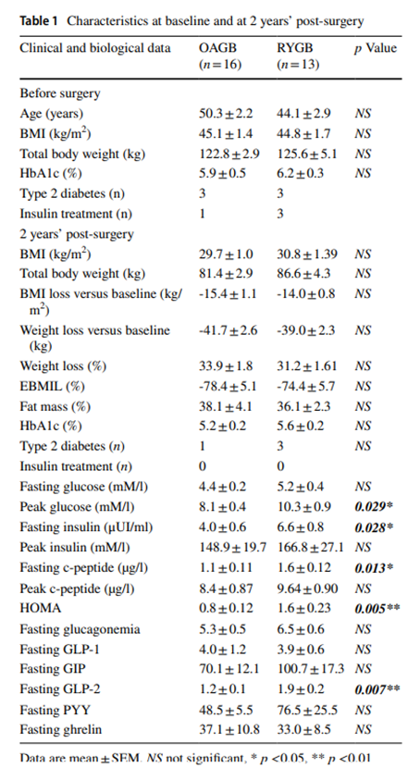

Slide 20
RESOLUTION OF COMORBIDITIES

Slide 21
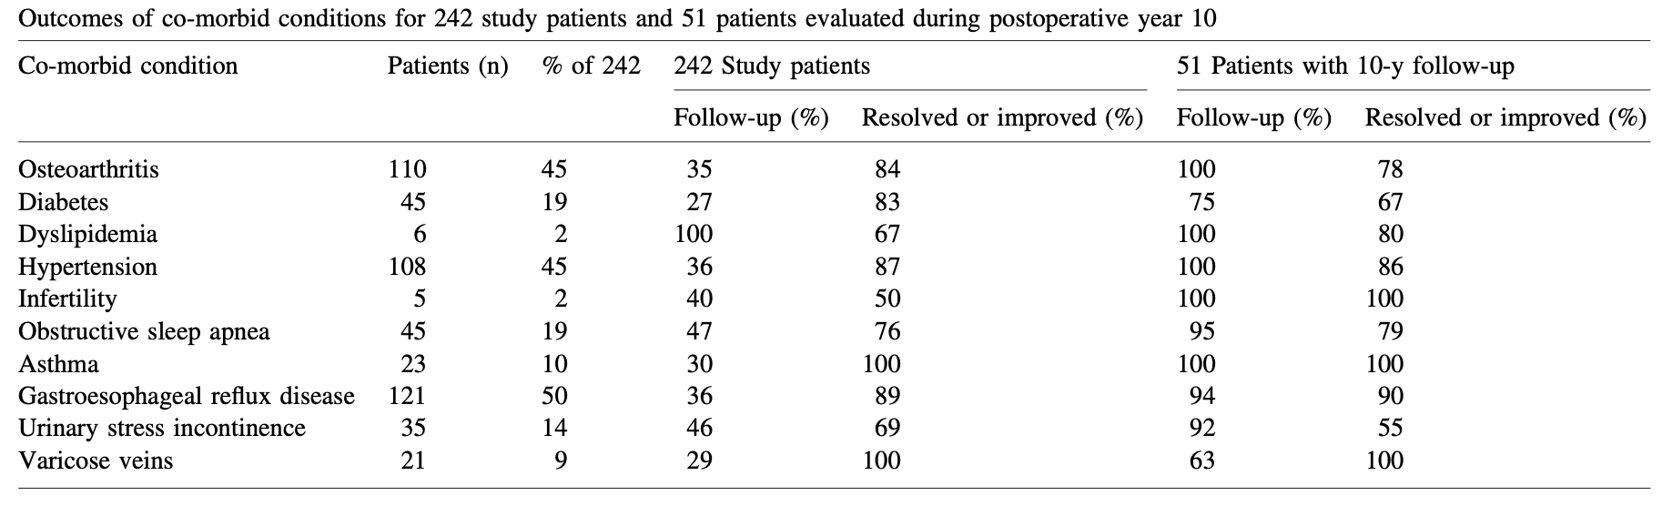

Slide 22
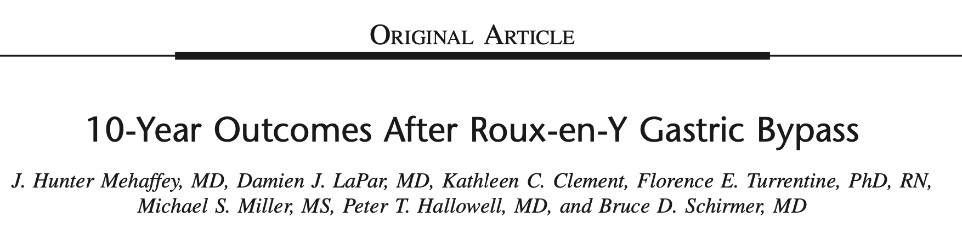
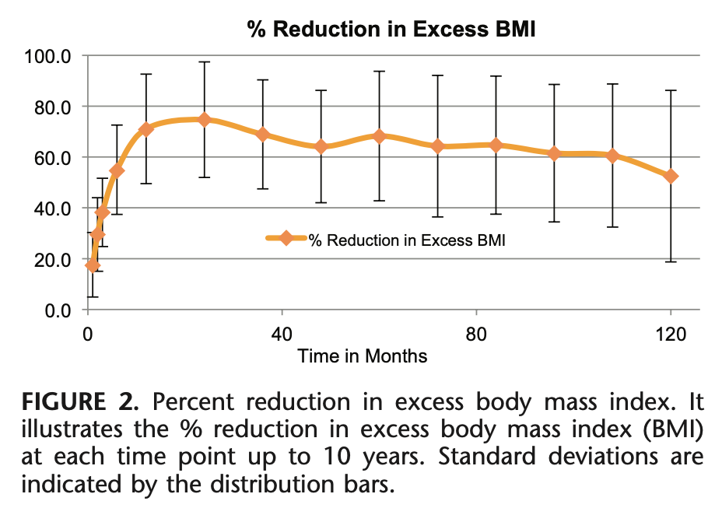
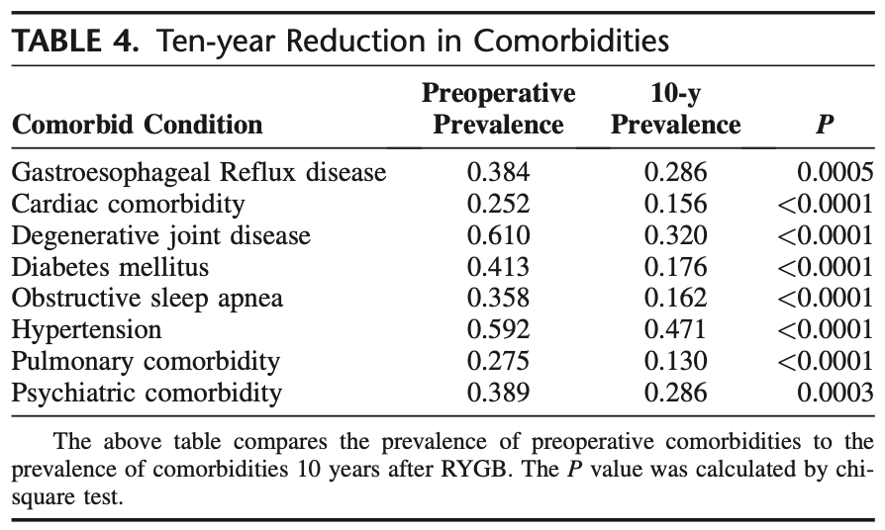
Roux-en-Y Gastric Bypass remains an excellent and durable operation for long-term weight loss and treatment of obesity-related comorbid disease.

Slide 23
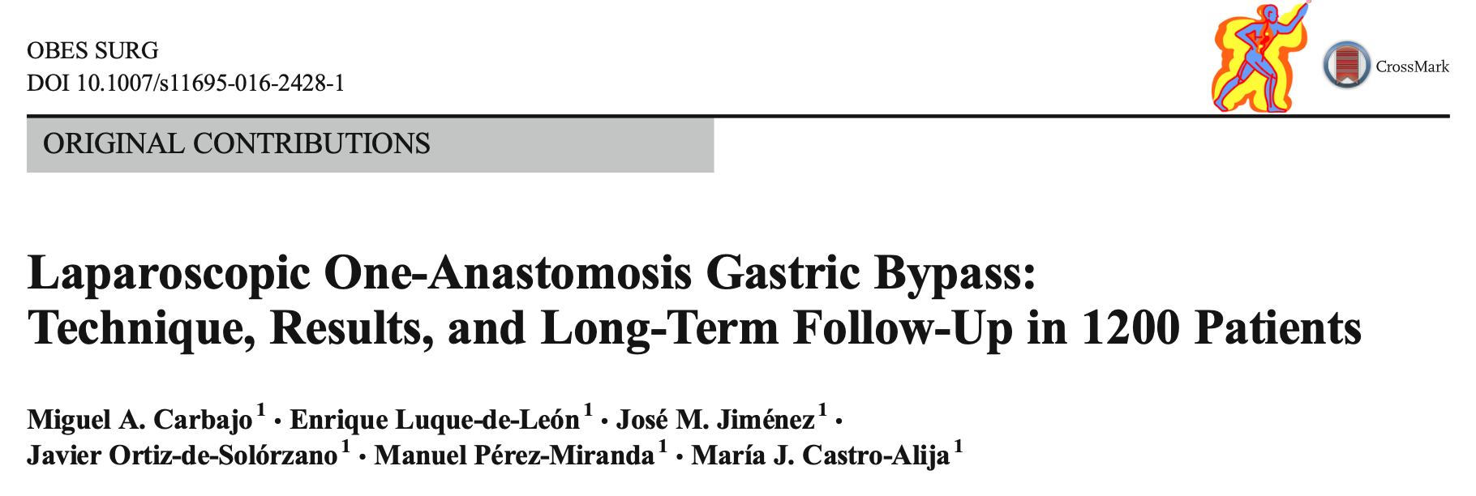
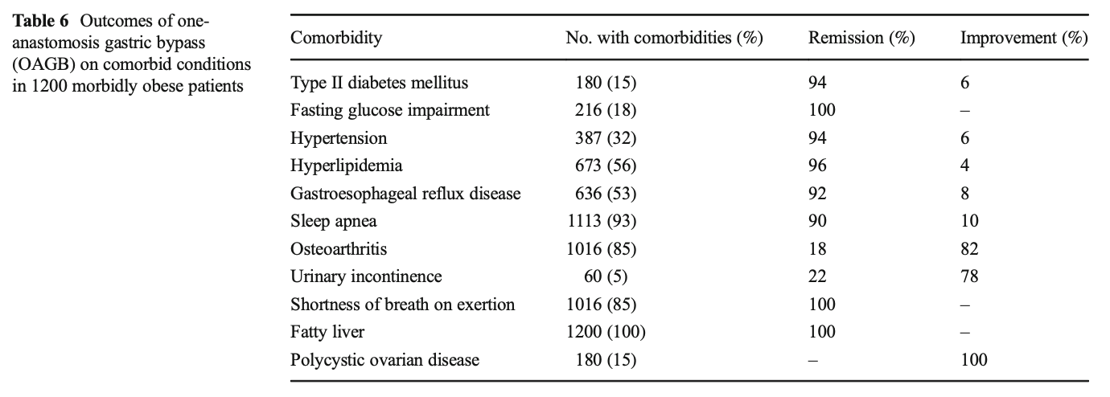
OAGB provides reduced difficulty and operating time, and very low morbidity and mortality.
Alkaline reflux (clinical and endoscopic) is very infrequent, mild, and treatable.
Development of subsequent cancer has not been reported.
Long-term substantial EWL, remission of comorbidities through its metabolic benefits, and degree of satisfaction are similar to the best results obtained with more aggressive and complex operations.
OAGB is a safe and effective powerful alternative which is slowly (but surely) becoming mainstream in bariatric surgery.

Slide 24
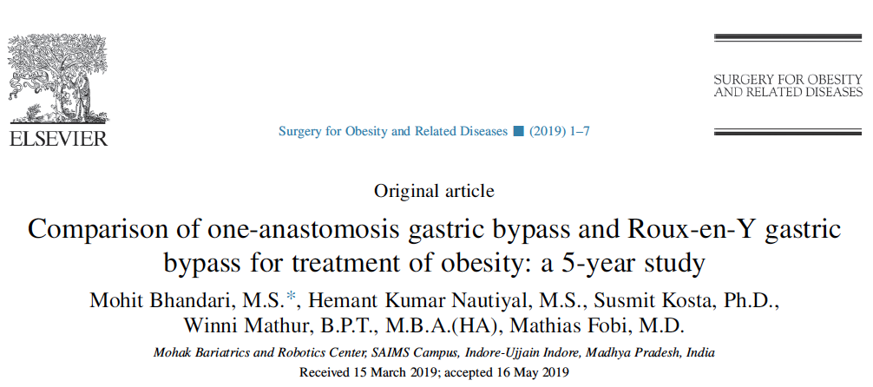
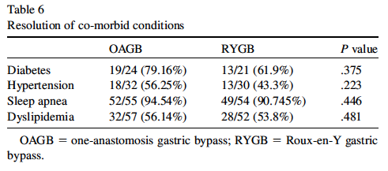


Slide 25
CONTROVERSIES…

Slide 26



Slide 27


OAGB and RYGB appear to be equal with respect to postoperative complications, bile reflux frequency, bile reflux index, and the Sydney system score

Slide 28




Slide 29



Exclusion criteria included a history of oesophagitis, severe gastro-oesophageal reflux disease
Gastritis and esophagitis occured also after RYGB
4 out of 6 esophagitis after OAGB were grade A
No accurate measurement of the gastric pouch length in the OAGB arm

Slide 30



Slide 31


This study clarified that OAGB had favorable comparable results with RYGB in patients with obesity having mild-to- moderate uncomplicated GERD with easier technique, less operative time, and fewer complications. Both procedures caused significant reduction in %TEAE and total episodes of reflux, acid, and weak acid reflux episodes with no significant difference between them. However, alkaline reflux was significantly more reduced in RYGB than OAGB at 6 and 12 months.

Slide 32




Slide 33



Slide 34



Slide 35

Obesity Surgery (2022 32:256-265)
A questionnaire was e-mailed to all S.I.C.OB. centres of excellence (annual caseload > 100; 5-year follow-up > 50%)
    Early complications (<30 days)
    Late complications (>30 days)
    Reoperation: surgical treatment of a complication (internal hernia repair…)
    Revisional procedure: modification of original technique or conversion to another intervention

Slide 36
Obesity Surgery (2022 32:256-265)
181 (2.08%) patients underwent a revisional procedure
Indications | Prevalence in revised population (n=181 patients) | Prevalence in the total population (n=8676 patients) | Onset time from OAGB-MGB (months)¹
DGER | 82 (45.3%) | 82 (0.94%) | 43.19 ± 37.52
Weight regain | 42 (23.2%) | 42 (0.48%) | 58.23 ± 35.14
Excessive Weight Loss | 16 (8.8%) | 16 (0.18%) | 19.50 ± 9.06
Marginal ulcer perforation | 12 (6.6%) | 12 (0.13%) | 26.36 ± 17.43
Gastro-gastric fistula | 10 (5.5%) | 10 (0.11%) | 71.67 ± 33.71
Marginal ulcer bleeding | 9 (4.9%) | 9 (0.10%) | 23.33 ± 20.20
Anastomotic stenosis | 5 (2.7%) | 5 (0.06%) | 8.00 ± 4.69
Diarrhea | 3 (1.6%) | 3 (0.03%) | 16.00 ± 6.92
Reactive Hypoglycemia | 2 (1.1%) | 2 (0.02%) | 5.50 ± 4.94

Slide 37



Slide 38


Slide 39

87 studies; 27.775 patients; 8 RCTs
6% rate of new onset reflux; 4% after PS; 10% after OAGB as RS
15% esophagitis; 13% grade A/B; 1% grade C/D; 1% Barrett’s esophagus; 16% after PS; 19% after OAGB as RS
Marginal Ulcers 3%; 3% after PS; 2% after OAGB as RS
Revisional Surgery to RYGBP 2%; 1% after PS; 6% after OAGB as RS

Slide 40




Slide 41



In particular, weakly alkaline refluxes were markedly higher than those recorded after MGB
(38 versus 0, P < .0001)

Slide 42



True junctional cancer occurring 2 years after OAGB-MGB
Preop Grade C esophagitis….
Pre-operative upper gastrointestinal endoscopy (UGIE) was not done…
12 years following primary OAGB
From 1997 to 2023, 4 documented cases of esophago-gastric cancer

Slide 43

OAGB may resemble BII but it is a completely different procedure and no assumption on OAGB can be based on outcomes of BII
The pressure gradient between the sleeve-shaped stomach and the jejunum acts as an active pump facilitating the flow of the bile into the intestine, while the length of the pouch avoids reflux into the esophagus
Interestingly, there are also evidences that at 1 year after surgery there is no difference in bile reflux after OAGB and Roux-en-Y Gastric Bypass
In conclusion we must remember that gastric cancer after OAGB is exceedingly rare
We do not really wonder about what will happen in ten years, since nothing very alarming happened after OAGB procedure in the last 24 years

Slide 44

50 studies
49.991 Pts
446 PTS (1.0%) requiring in hospital treatment
BPL length < 150 cms 5 pts (1.1%)
BPL length > 150 cms 151 pts (33.9%)
Unknown in 290 pts (65%)

Slide 45

To be reminded…
Factors influencing absorption at level of small bowel
Liver secretion
Pancreas secretion
Immunological status
Length of intestinal villi
Bacterial growth
Small bowel motility
Small bowel length

Slide 46
Conclusions 1
OAGB works probably due to a double mechanism of action, restriction, especially at beginning, and hypoabsorption, later
Small bowel length is a gross criterion, but remains an acceptable criterion, even though a standardization of the procedure remains mandatory
Biliopancreatic limb should be tailored according to body-mass index (BMI)
Maintain at least 300 cm of common channel
More than 50% of morbid obese patients candidated to BMS present GERD
GERD following OAGB does not involve esophagus in vast majority of published series
GERD following OAGB is often present in the gastric pouch but no specific symptoms or mucosal reflux related damage have been described so far (27 years)
Although more RCTs remain welcome, and reminding us in surgery «one size does not fit all», based on published evidence, OAGB seems a viable procedure especially in morbid obese (BMI>45) or super obese patients, even in presence of preoperative mild to moderate reflux

Slide 47
Conclusions 2
The magnitude of weight loss appears to be at least equivalent to RYGB and potentially superior to SG and GB
Quantitative analysis demonstrated that weight loss was greater for patients who had OAGB as their primary operation when compared to patients who had the OAGB as revision surgery after SG and GB
OAGB appears to have favorable effects on T2DM remission, as detected in the quantitative analysis, as well as in the qualitative analysis, both in short-term and in medium-term follow-up studies, i.e., after 24 months and 60 months, respectively
The effects of OAGB on HTN, OSAS and dyslipidemia also seemed favorable, but the data are too few and follow up is too short to be conclusive
The current literature suggests that OAGB is a safe procedure. The percentage of early perioperative complications is low, even in comparison with RYGB
Bile reflux is described as a reason for conversion from OAGB to RYGB in several studies, however this does not seem to be a frequent problem in the quantitative and qualitative studies analyzed
In the quantitative studies we reviewed, no cases of cancer were reported

